Slide 1

CONSTRUCTION SITE SAFETY GEAR DETECTION
PRESENTED BY~
SUDHANSHU
SARTHAK

Slide 2
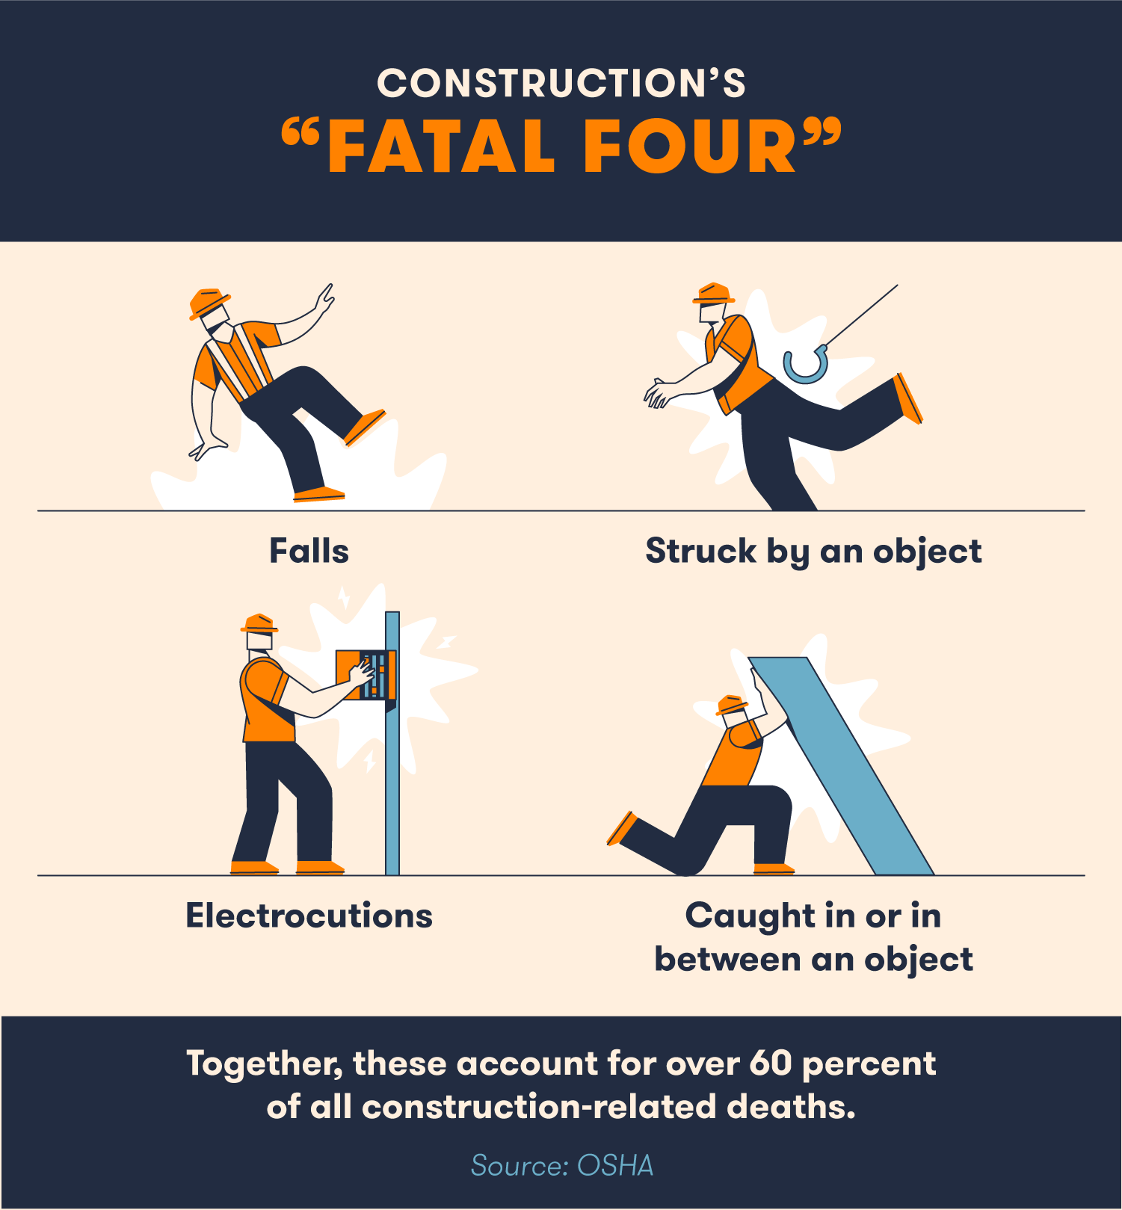
PROBLEM
STATEMENTS
Every year around 48000 people die at work in india.
Every day around 38 workers die on construction site.
80% increase in the injury rate in last 4 years.

Slide 3
INTRODUCTION

Slide 4
The Construction sector has suffered a very high accidents rates as compared to other sectors.
The safety of construction workers has been a primary cause of concern for project managers for a long time.
India has one of the highest accident rates in the world with 15.8 incidents per 1000 workers/year.
Studies have shown that adopting proactive measures has reduced accident rates in various countries.

Slide 5

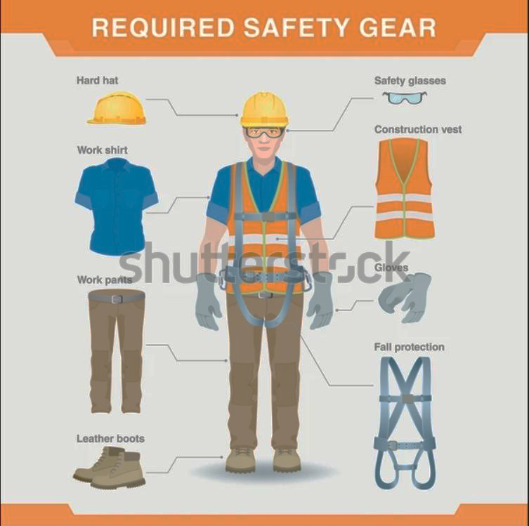
we can solve this manually but it will require a lot of money and require lot off man power and humans have the tendancy to do mistake.
So to solve this problem we are making Artificial Intelligence system using Computer Vision to detect safety gears.

Slide 6
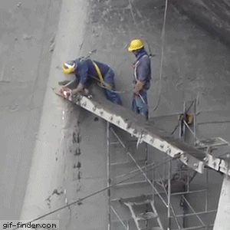
This is why safety gears are importants at construction sites

Slide 7
PROPOSED SYSTEM
1
2
3
4
We will able to predict images and also live camera recording.
This application allows real time input of images and videos.
In this we will make one application where anyone can upload images and videos and live feed.
This Application is Safety gear detection System.

Slide 8
FEASIBILITY
STUDY
1
Technical :
Risk assessment and Solutions
2
Operational:
User friendly interface, non technical user
3
Economical:
Cost effective, open source

Slide 9
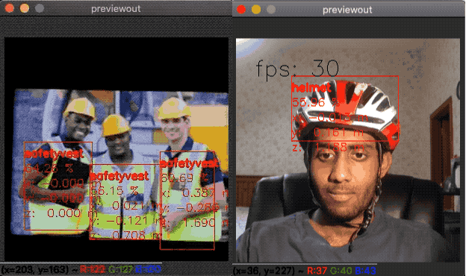
Objective
The objective of this study is to develop a scalable computer vision based deep learning framework to detect PPE compliance. The study achieved this objective using the context of hard hats and safety jacket detection on the construction site.
To achieve this objective, the study utilizes convolutional-neural networks – a class of deep learning computer vision algorithms that process the data, develop, train, and validate the model.

Slide 10

Machine learning approach

Slide 11
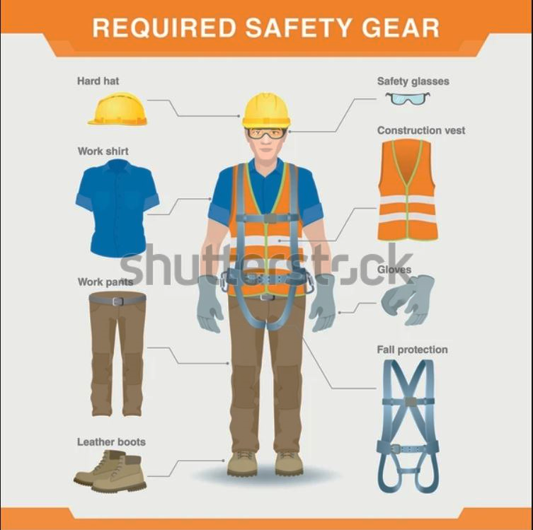
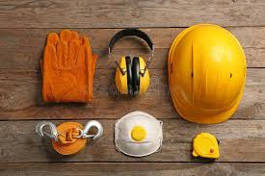
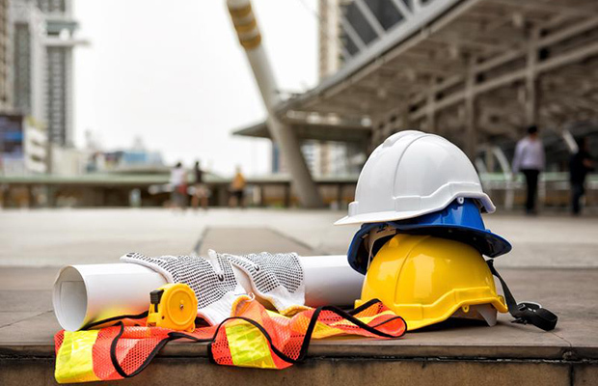
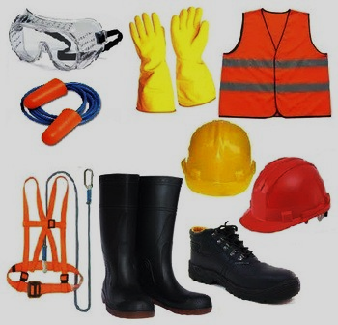
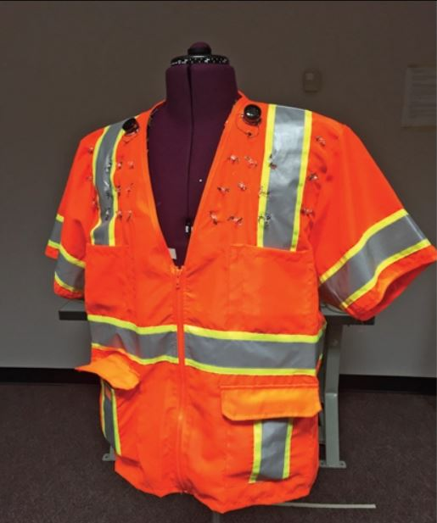
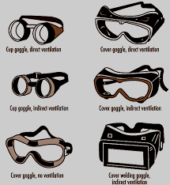
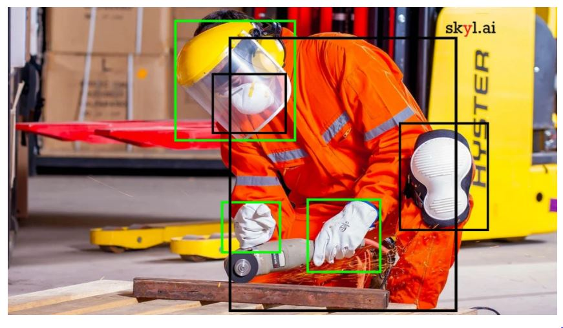
DATA SET
These are the inputs data set which is used to train our model based on object detection.

Slide 12
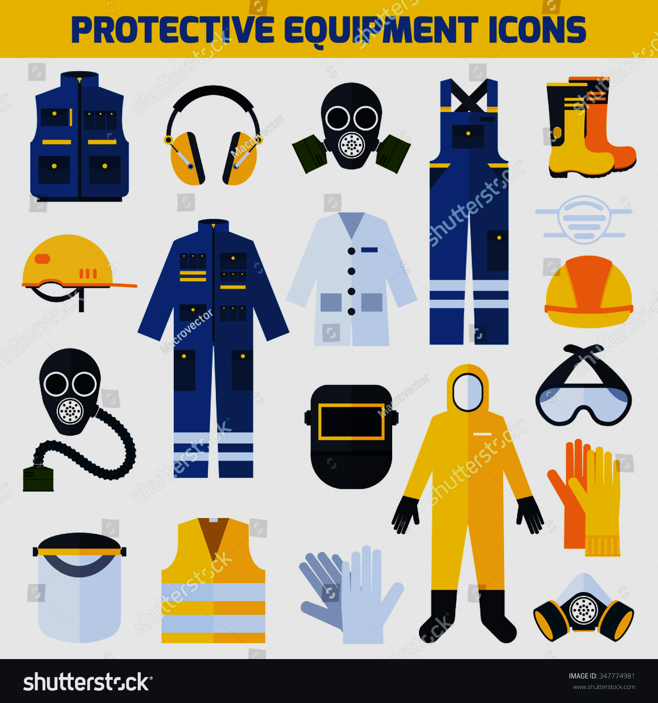
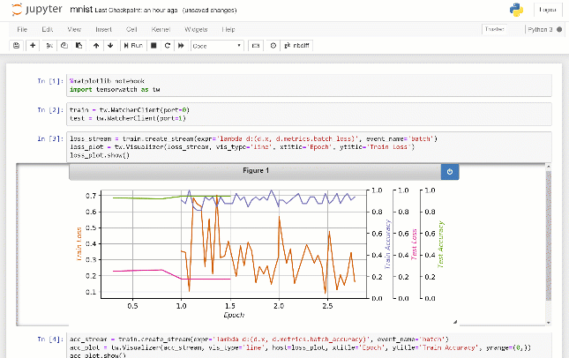
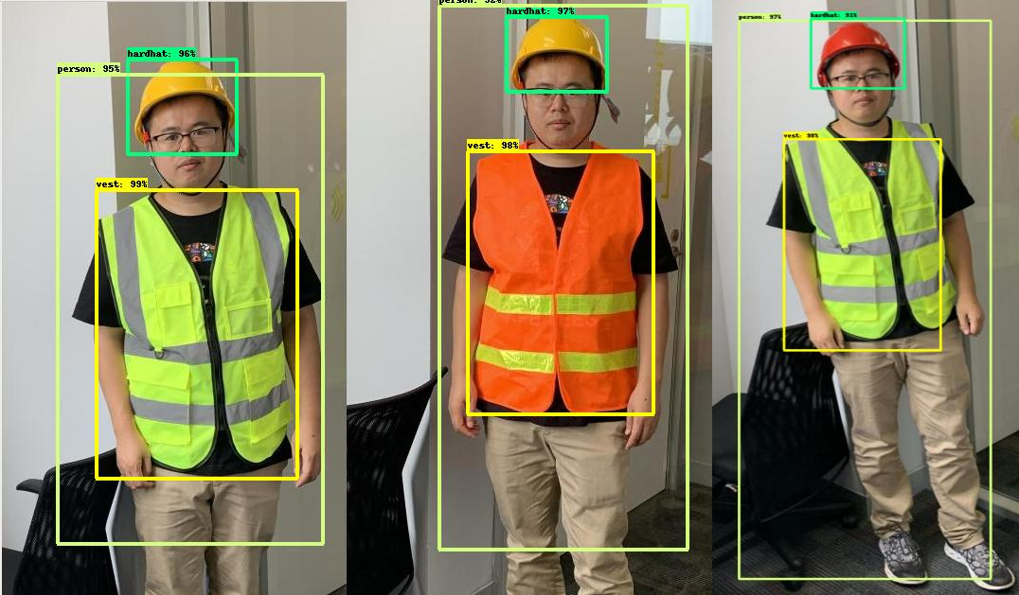

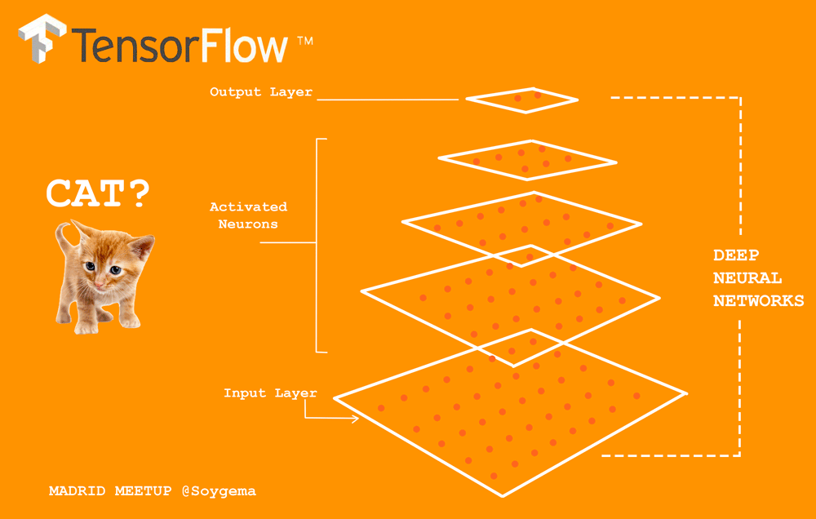
Process Description
Image Preprocessing
Model Training
1
3
5
2
4
Dataset Collection
Model Architecture
creation
Model Performance
Visualization

Slide 13
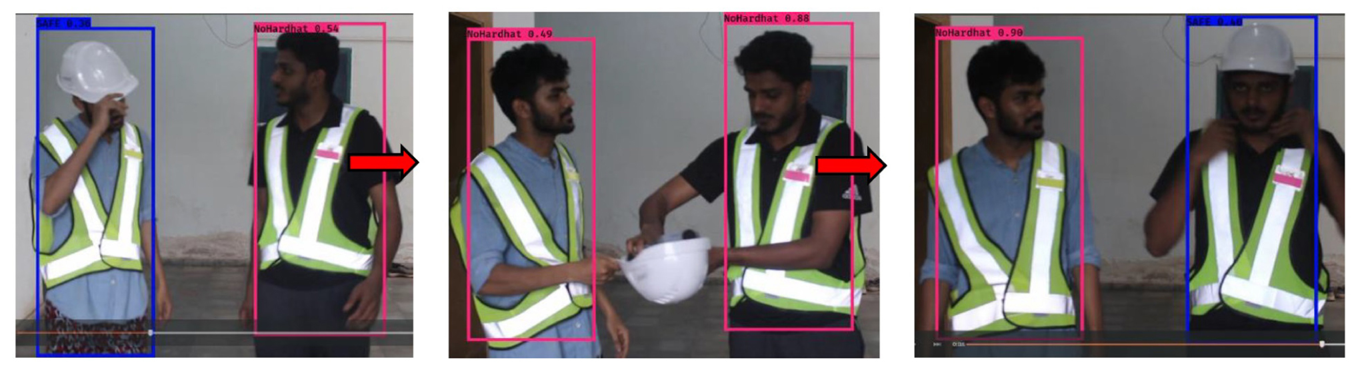
Model Testing and Score
Database manager
6
8
10
7
9
Model Persistence system
Web cam Controller
View display system

Slide 14
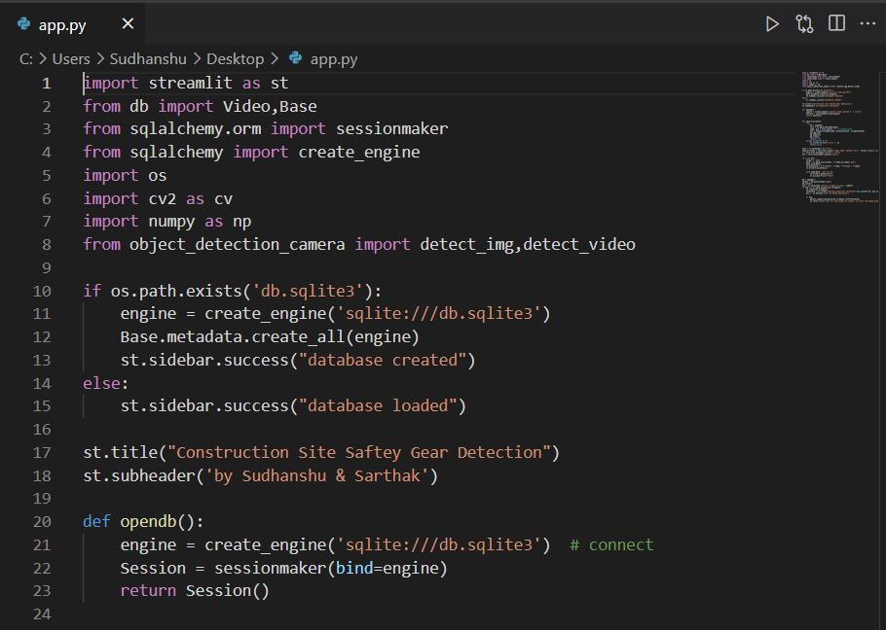
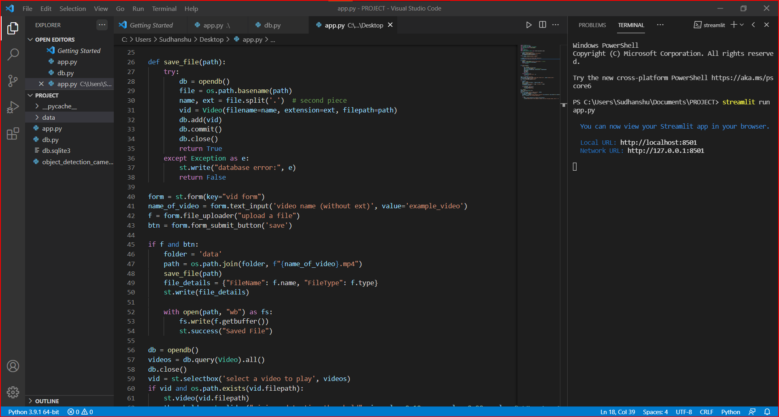
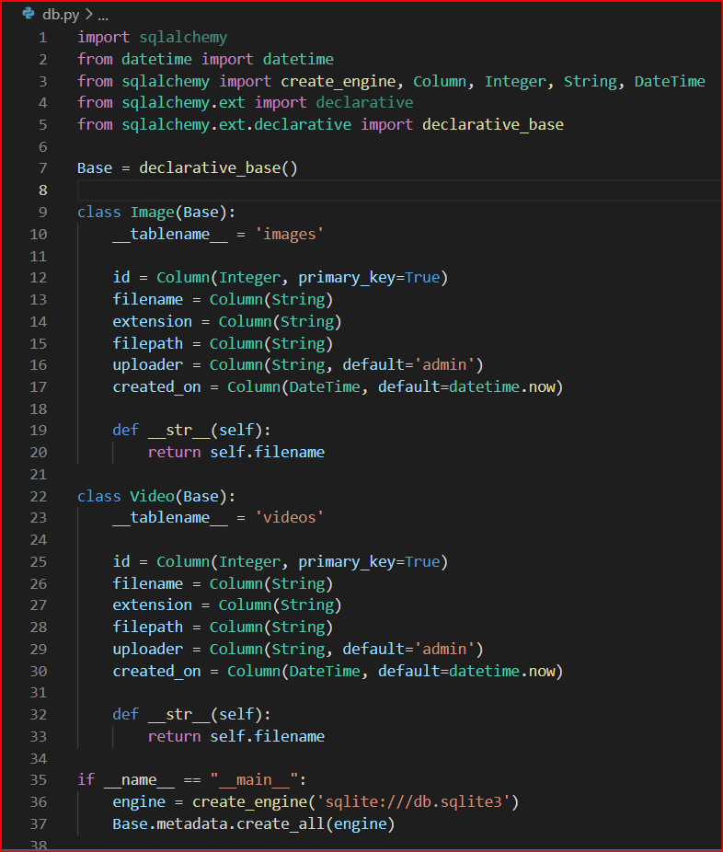
WEB APPLICATION
DATABASE PY-SCRIPT

Slide 15
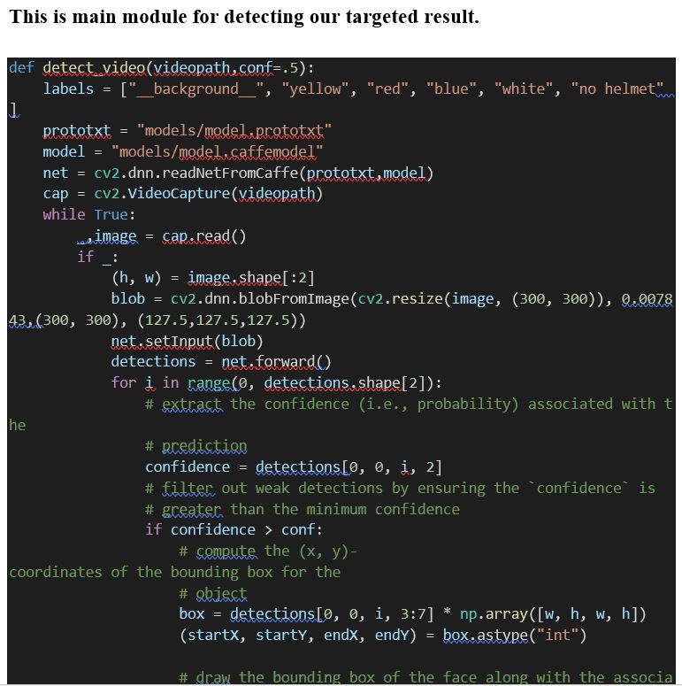
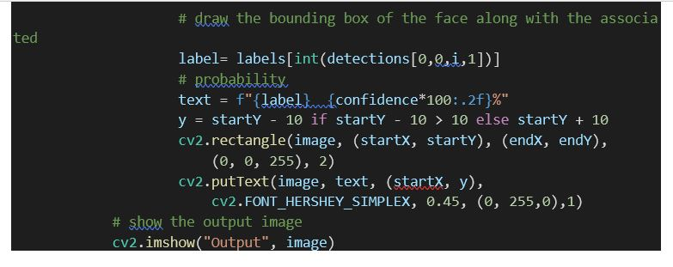
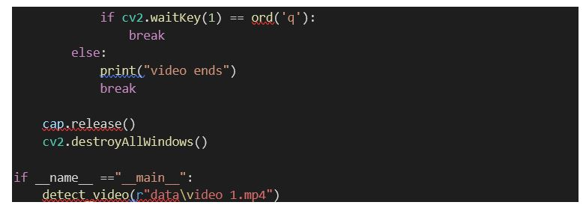
Object detection.py

Slide 16

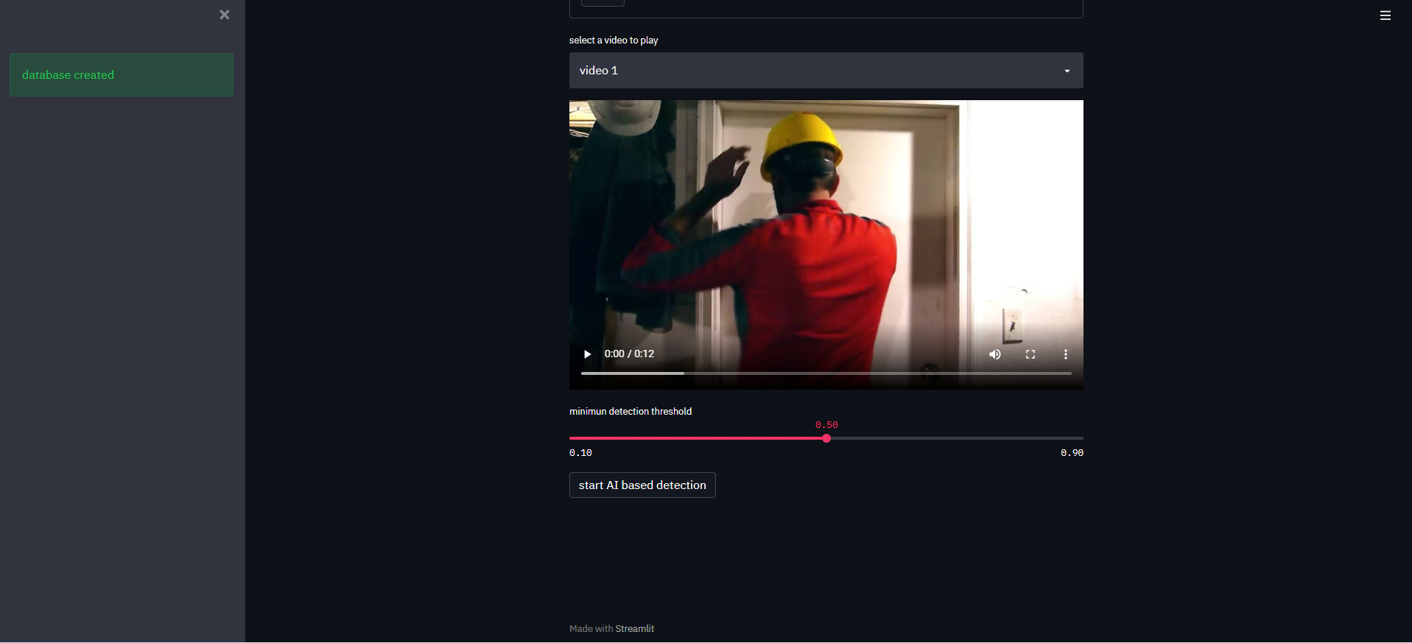
WEB APPLICATION

Slide 17
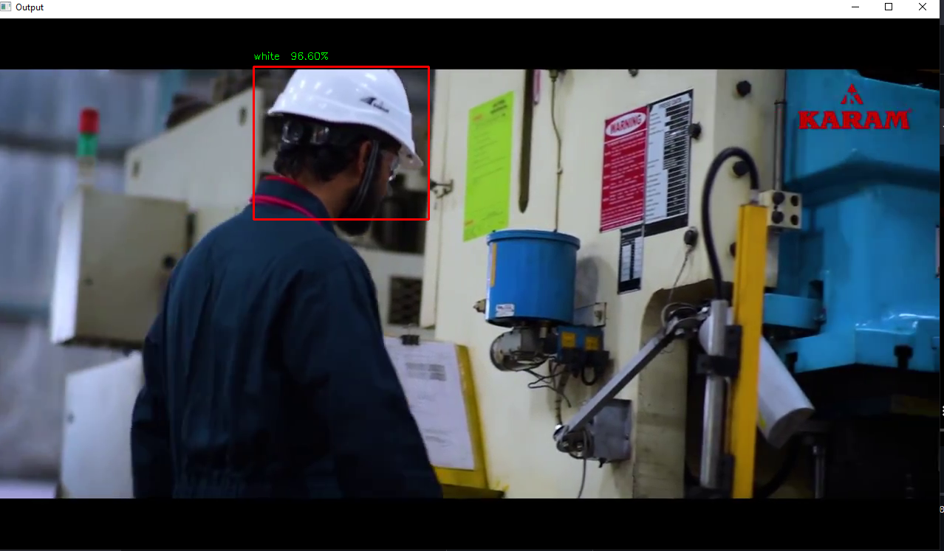
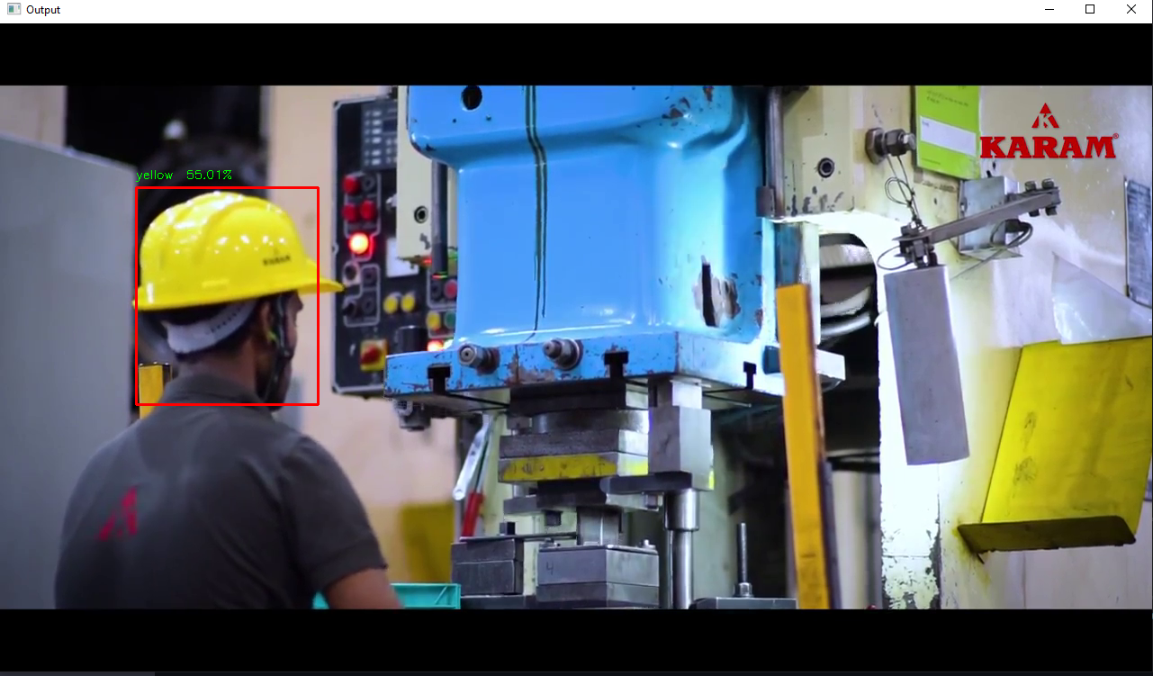
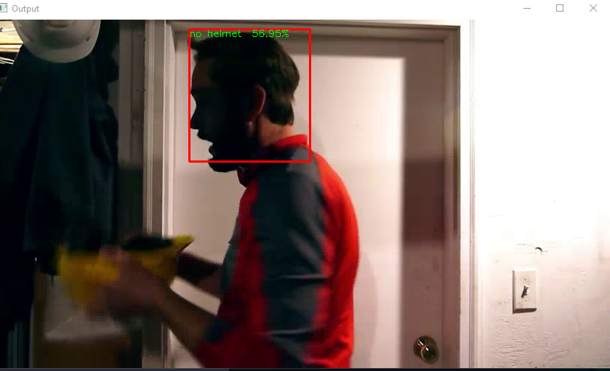
THIS IS HOW OUR SYSTEM WILL DETECT SAFETY GEARS

Slide 18
GANTT CHART
TODAY
Task | 4Feb- 28Feb | 28Feb- 9Mar | 10Mar- 12Apr | 13Apr-16May | 17May-22May | 23May-28May
Develop project proposal
Analysis
Designing
Coding
Unit Testing
Implementation
25 days
10 days
30 days
34days
5 days
5 days

Slide 19
Logical and physical design

Slide 20
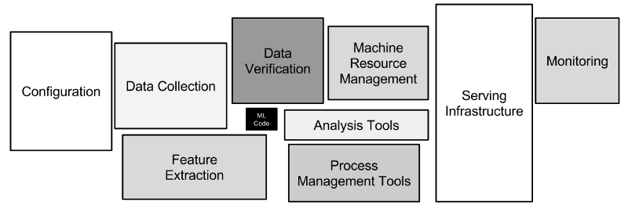
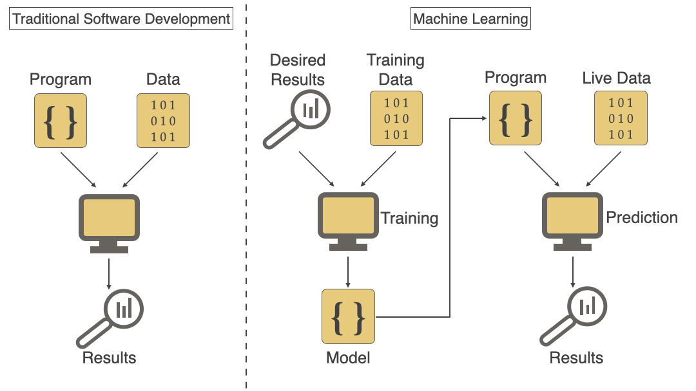
Class diagram

Slide 21
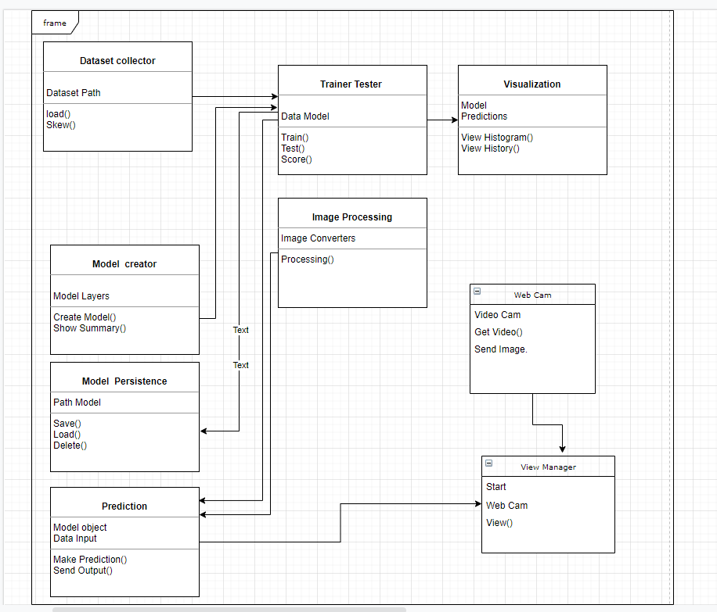

Slide 22
Use case diagram

Slide 23
Collect dataset
Clean dataset
Developer
Configure database
Design architecture
Train AI model
Check accuracy
prediction
AI model
Input data image
User

Slide 24
Software requirement specification (srs)

Slide 25
hardware Requirement
developer Side
Client Side
Processor : Quad Core or above
RAM : 8 GB or above
Disk space : 500 GB (SSD preferred)
Monitor : 15’’
GPU : Nvidia (CUDA enabled)
GPU (mem) : 2 GB or above
Others : Webcam, Keyboard, Internet Connection,
Mouse
Processor : Dual Core or above
RAM : 4 GB
Disk space : 500 GB
Monitor : 15’’
Others : Webcam, Keyboard,
Mouse,
Internet Connection

Slide 26



software Requirement
Client Side
Server Side
Web Browser : Google Chrome
Firefox
IE9 or above
Web Browser (chrome,FF,IE9 or )
Windows 10 or above / Linux
Anaconda IDE
Python 3.7 or above
Libraries: pandas, OpenCV, NumPy, scikit learn, TensorFlow

Slide 27
conclusion
This project will help to bring down the causality rate in the construction site and increase the safety of the workers at the construction site, this uses the concept of computer vision, convolution neural network and Deep Learning.

Slide 28


